Slide 1
Linear Regression Assignment Life_Expectancy Prediction
Supriyo Barik –IVY Professional school

Slide 2
OBJECTIVE
1) We got the dataset related to life expectancy named “Life_Expectancy_Data.csv.” In this project, we have received the average life expectancy of people of 193 Countries. We have to predict next year’s value of average life expectancy.
2) As per the goal of the project, we are running a Linear regression on Life_expectancy(Y), to analyze the influence of several independent factors (Country, Year, Status, Adult_Mortality, Infant_Deaths, Alcohol, Percentage_Expenditure, Hepatitis_B, Measles, BMI, Under-five_Deaths, Polio, Total_Expenditure, Diphtheria, HIV/AIDS, GDP, Per_Capita_GDP, Population, Thinness_1-19_Years, Thinness_5-9_Years, Income_Composition_of_Resources, and Schooling) that affect dependent / target variable Y.

Slide 3
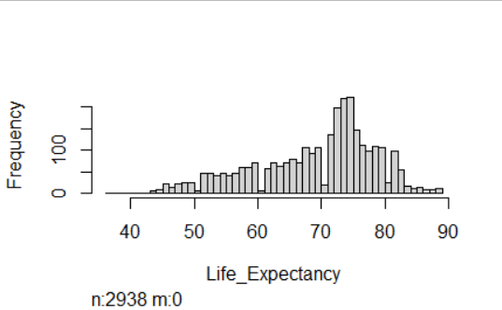
DEPENDENT VARIABLE
*** The dependent variable/target variable is Life_expectancy. It is a continuous column. Hence we will run a linear regression model. It represents the age of the person.
*** Graphical representations of the target variable:

Slide 4
Count of variables and observations
*** The Structure of the dataset is 2938 obs. of 23 variables.

Slide 5
SIGNIFICANT VARIABLES
Year (2007, 2008, 2009, 2010, 2011, 2012, 2013, and 2014)
Adult_Mortality
BMI
Under_five_Deaths
Polio
Total_Expenditure
Diphtheria
HIV_AIDS
Per_Capita_GDP
Thinness1to19Years
Income_Composition_of_Resources
*** These variables are satisfied the multicollinearity test of the model as well.

Slide 6
INSIGNIFICANT VARIABLES
Country
Remaining Years
Status
Infant_Deaths
Alcohol
Percentage_Expenditure
Hepatitis_B
Measles
GDP
Population
Thinness_5-9_Years
Schooling

Slide 7
Explanation of significant variables
*** Based on the p value, we can finalize the importance of independent variables on the target variable.
** Variables P-Value Significance
I(Year == 2007) 0.025270 Significant at 95% confidence
I(Year == 2008) 0.049842 Significant at 95% confidence
I(Year == 2009) 0.039742 Significant at 95% confidence
I(Year == 2010) 0.064018 Significant at 90% confidence
I(Year == 2011) 0.006998 Significant at 99% confidence
I(Year == 2012) 0.007568 Significant at 99% confidence
I(Year == 2013) 0.019319 Significant at 95% confidence
I(Year == 2014) 0.023339 Significant at 95% confidence

Slide 8
Explanation of significant variables (Cont.)
** Variables P-Value Significance
Adult_Mortality < 0.0000000000000002 Significant at 99.5% confidence
BMI 0.00000000000062 Significant at 99.5% confidence
Under_five_Deaths 0.001536 Significant at 99% confidence
Polio 0.000863 Significant at 99.5% confidence
Total_Expenditure 0.000761 Significant at 99.5% confidence
Diphtheria 0.000239 Significant at 99.5% confidence
HIV_AIDS < 0.0000000000000002 Significant at 99.5% confidence
Per_Capita_GDP < 0.0000000000000002 Significant at 99.5% confidence
Thinness1to19Years 0.00003387704207 Significant at 99.5% confidence
Income_Composition_
of_Resources < 0.0000000000000002 Significant at 99.5% confidence

Slide 9
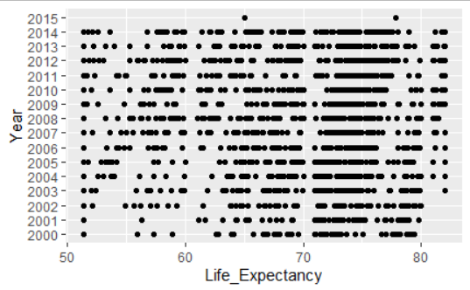
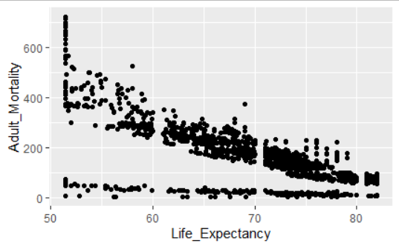
Graphical display of significant variables
Variable1: Year
Variable2: Adult_Mortality

Slide 10
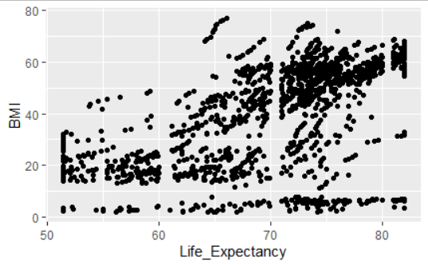
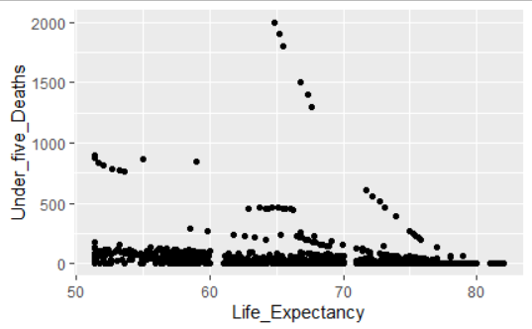
Graphical display of significant variables (Cont.)
Variable3: BMI
Variable4: Under_five_Deaths

Slide 11
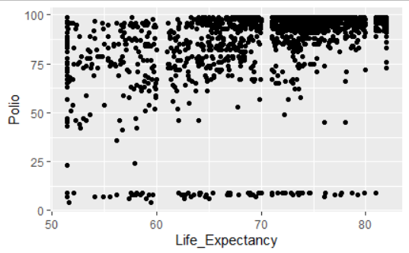
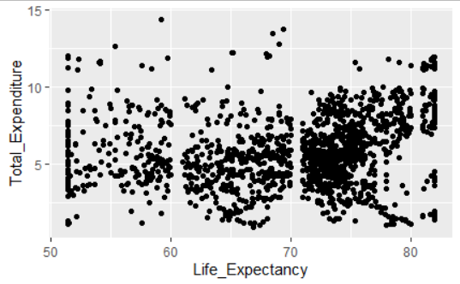
Graphical display of significant variables (Cont.)
Variable5: Polio
Variable6: Total_Expenditure

Slide 12
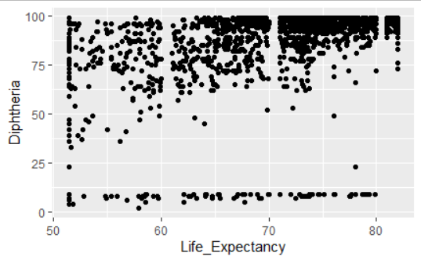
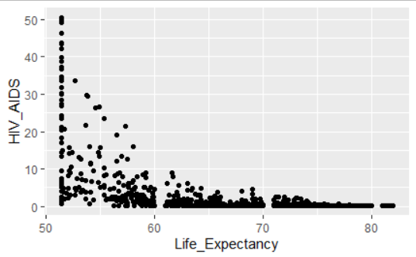
Graphical display of significant variables (Cont.)
Variable7: Diphtheria
Variable8: HIV_AIDS

Slide 13
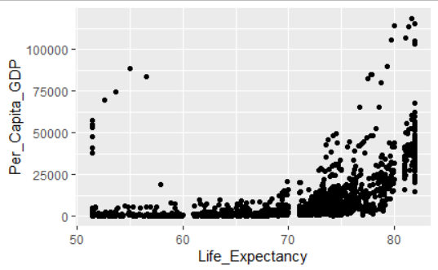
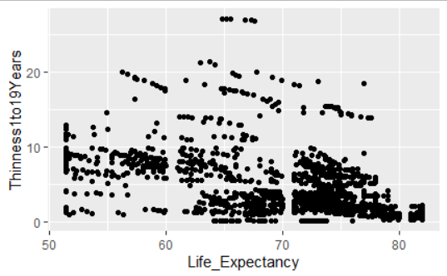
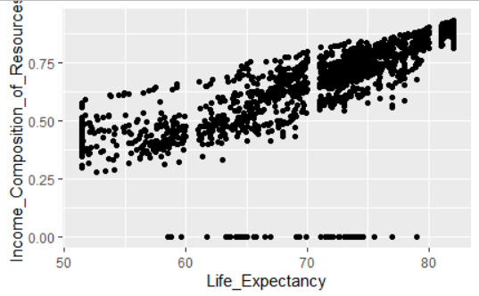
Graphical display of significant variables (Cont.)
Variable9: Per_Capita_GDP
Variable10: Thinness1to19Years
Variable11: Income_Composition_of_Resources

Slide 14
RESULTS OBTAINED
*** Key and mandatory mentions for this R-Project:
R-square and adjusted-R-square: 0.7799865 and 0.7720693
Bp-test outcome and interpretation: < 0.00000000000000022
It means that the Null hypothesis is accepted and Homoscedasticity exists
Ad-test outcome and interpretation: 0.000000000001568
It means the test rejects the hypothesis of normality (p-value is less than 0.05)
dwtest / Dwt-test outcome and interpretation: 0
It means that the p-value is <0.05, we reject H0, and it is positive autocorrelation
MAPE value, model accuracy score, and implication:
MAPE: 0.0427. (The average difference between the forecasted value and the actual value is 4%. It is an excellent result)
Prediction error, RMSE: 3.58. (The standard deviation of the unexplained variance. Lower values of RMSE indicate a better fit. Hence, Good)
Accuracy Score: 78%. It indicates that the model better predicts the outcome at 78%.

Slide 15
Variable relationships
*** Positive variables:
BMI, Polio, Total_Expenditure, Diphtheria, Per_Capita_GDP, and Income_Composition_of_Resources
*** Negative Variables:
Year (2007, 2008, 2009, 2010, 2011, 2012, 2013, and 2014), Adult_Mortality, Under_five_Deaths, HIV_AIDS, and Thinness1to19Years

Slide 16
Business RECOMMENDATIONs
The year, which is 2001 has more life_expectancy than the year 2007.
The year, which is 2001 has more life_expectancy than the year 2008.
The year, which is 2001 has more life_expectancy than the year 2009.
The year, which is 2001 has more life_expectancy than the year 2010.
The year, which is 2001 has more life_expectancy than the year 2011.
The year, which is 2001 has more life_expectancy than the year 2012.
The year, which is 2001 has more life_expectancy than the year 2013.
The year, which is 2001 has more life_expectancy than the year 2014.
The number of people those who are under the adult_mortality has less life_expectancy than who are over the adult_mortality range.
The number of people who are under the stable BMI has more life_expectancy than others (beyond the range).

Slide 17
Business RECOMMENDATIONs (Cont.)
The number of people who are under_five_deaths has less life_expectancy than those who are over_five_deaths.
The number of people who took polio has more life_expectancy than those who are not taken.
The number of people who are under the total_expenditure has more life_expectancy than others (beyond the range).
The number of people who took DTP3 (Diphtheria) has more life_expectancy than those who are not taken.
The number of people who had suffered HIV_AIDS has less life_expectancy than those who had not suffered.
The number of people whose Per_Capita_GDP is high has more life_expectancy than who’s Per_Capita_GDP is low.
The number of people whose prevalence of thinness between 1 to 1.9 has less life_expectancy than whose prevalence of thinness is higher.
The number of people who have a good range of Income_Composition_of_Resources has more life_expectancy than others (beyond the range).

Slide 18

THANK YOU

